Slide 1
World of Warcraft Player vs Player (PVP) Character Analysis
Scripting for Data Analysis
Noah Mott and Leticia Spencer
Project Presentation

Slide 2
Agenda
Program Description
Data and its sources
Analysis Question #1
Analysis Question #2
Output
Conclusion

Slide 3

Program Description
This program is designed to pull in data from the Blizzard Application Programming Interface (API). This project focuses on the 3 versus 3 (3v3) Player versus Player (PVP) leaderboard.
Our goal was to gather insights about the selections and statistics that make up a winning player in PVP.

Slide 4
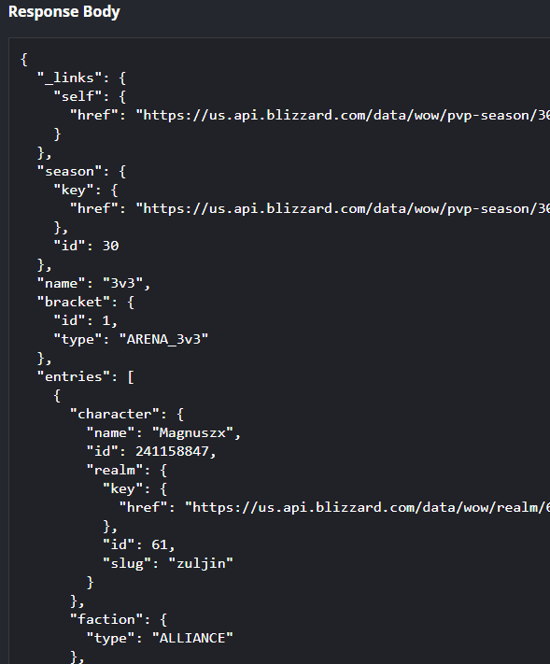
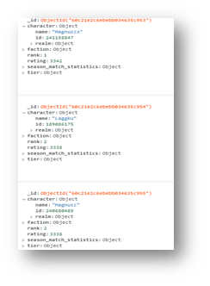
Data and it’s sources
Data was initially pulled from the Blizzard API
Data was pulled in from the 3v3 Leaderboard Endpoint
Looping through the leaderboard to get the statistics endpoints for each player
Data was uploaded into the MongoDB Atlas Cloud Database and accessed from there.

Slide 5
Question #1
• What is the distribution of the top 1000 3v3 players by faction choice.
We can see from the results below the specific counts of the 1000 players on the 3v3 leaderboard.
Note the disparity in horde players vs alliance players. More than twice as many players on the leaderboard have selected horde characters.

Slide 6
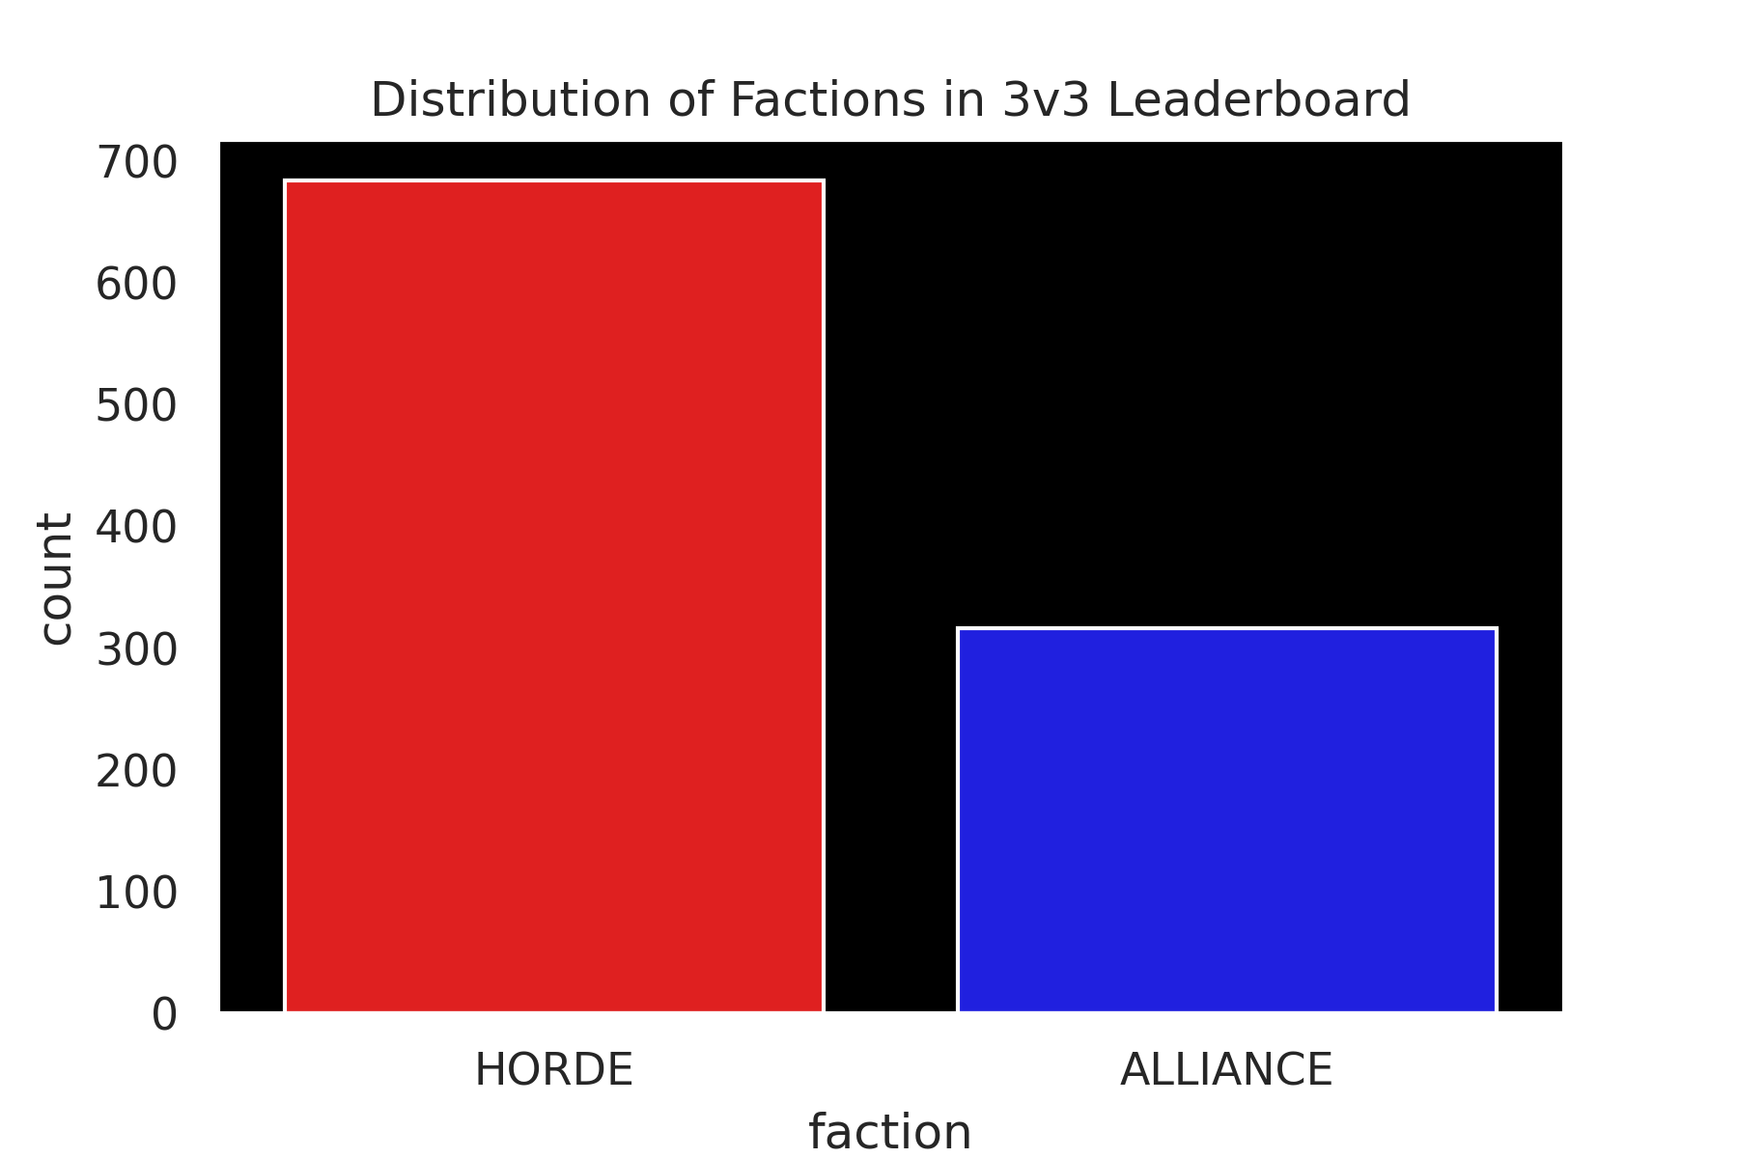

Distribution of Classes and Roles on the 3v3 Leaderboard

Slide 7
Question #2
What is the distribution by class on the 3v3 leaderboard?
We can see from the results of this graph that the most chosen class of those on the leaderboard is the Paladin.
Additionally, priests have a similar ability. While priests can only wear cloth, they make up for their lack of armor by having a great deal of mitigation, a magical absorption shield, and the ability to do a great deal of damage or healing depending on the specialization chosen.
Interestingly, Warlocks, Hunters, and Demon Hunters tend to be lower in the numbers. Warlocks and Hunters are likely lower because so much of their damage is attributed to their pets or companions, non-player characters who use artificial intelligence to cause damage.
Demon Hunters are likely selected lower because they are currently considered broken as a class, doing very low damage currently.

Slide 8
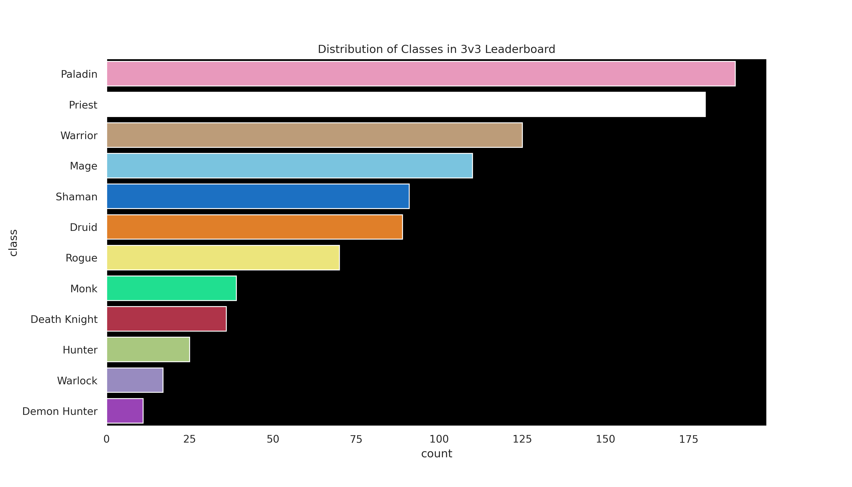
Distribution of Classes and Roles on the 3v3 Leaderboard

Slide 9
Question #3
• What is the distribution of the top 1000 3v3 by the role of the player?
Noticeable right away is the vast difference between the different roles. This disparity is due to two factors. First, there are simply far more damage dealer specializations in the game as opposed to each of the other two. This accounts for a larger number of damage dealer roles. However, the number of tanks is interesting. Such a low number is indicative of the fact that players who typically play against other players as opposed to playing against the environment of the game like the utility that damage dealers and healers have access to.
Players tend to be far more unpredictable, so a role that is designed specifically for taking damage by keeping a non player character (NPC) focused on them is somewhat useless when a human player will know quickly where the biggest threat is coming from and adapt to deal with it.

Slide 10
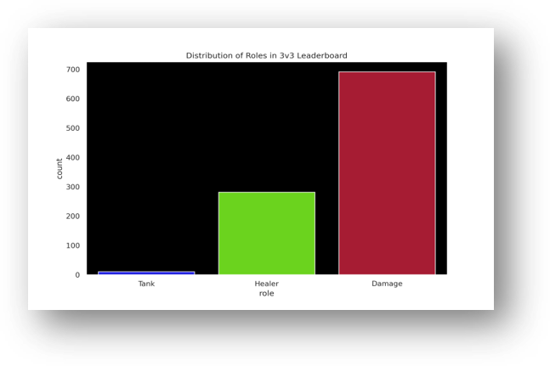
Distribution by Role
Roles: Healer, Tank, Damage Dealer (DPS)
DPS more common
Tanks almost non-existent
Reasons
Mechanics
PVE vs PVP

Slide 11

Conclusion
World of Warcraft has been able to, for the most part, been able to balance out their characters with relation to power and abilities
If you want to play both versus the environment or vs other players you must shift between specializations and equip completely different sets of items
the belief is still strong that Demon Hunters are a broken class for PVP
intellect seems to be the best predictor of total wins
Gender selection on it's own is not a good predictor of total wins

Slide 12


Q&A

